Slide 1
Harlow’s experiments on attachment in monkeys

Slide 2
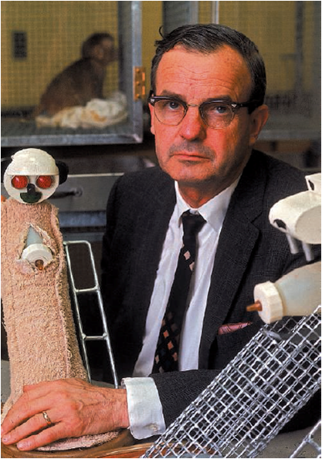
American psychologist Harry Harlow conducted many experiments on attachment using rhesus monkeys

Slide 3
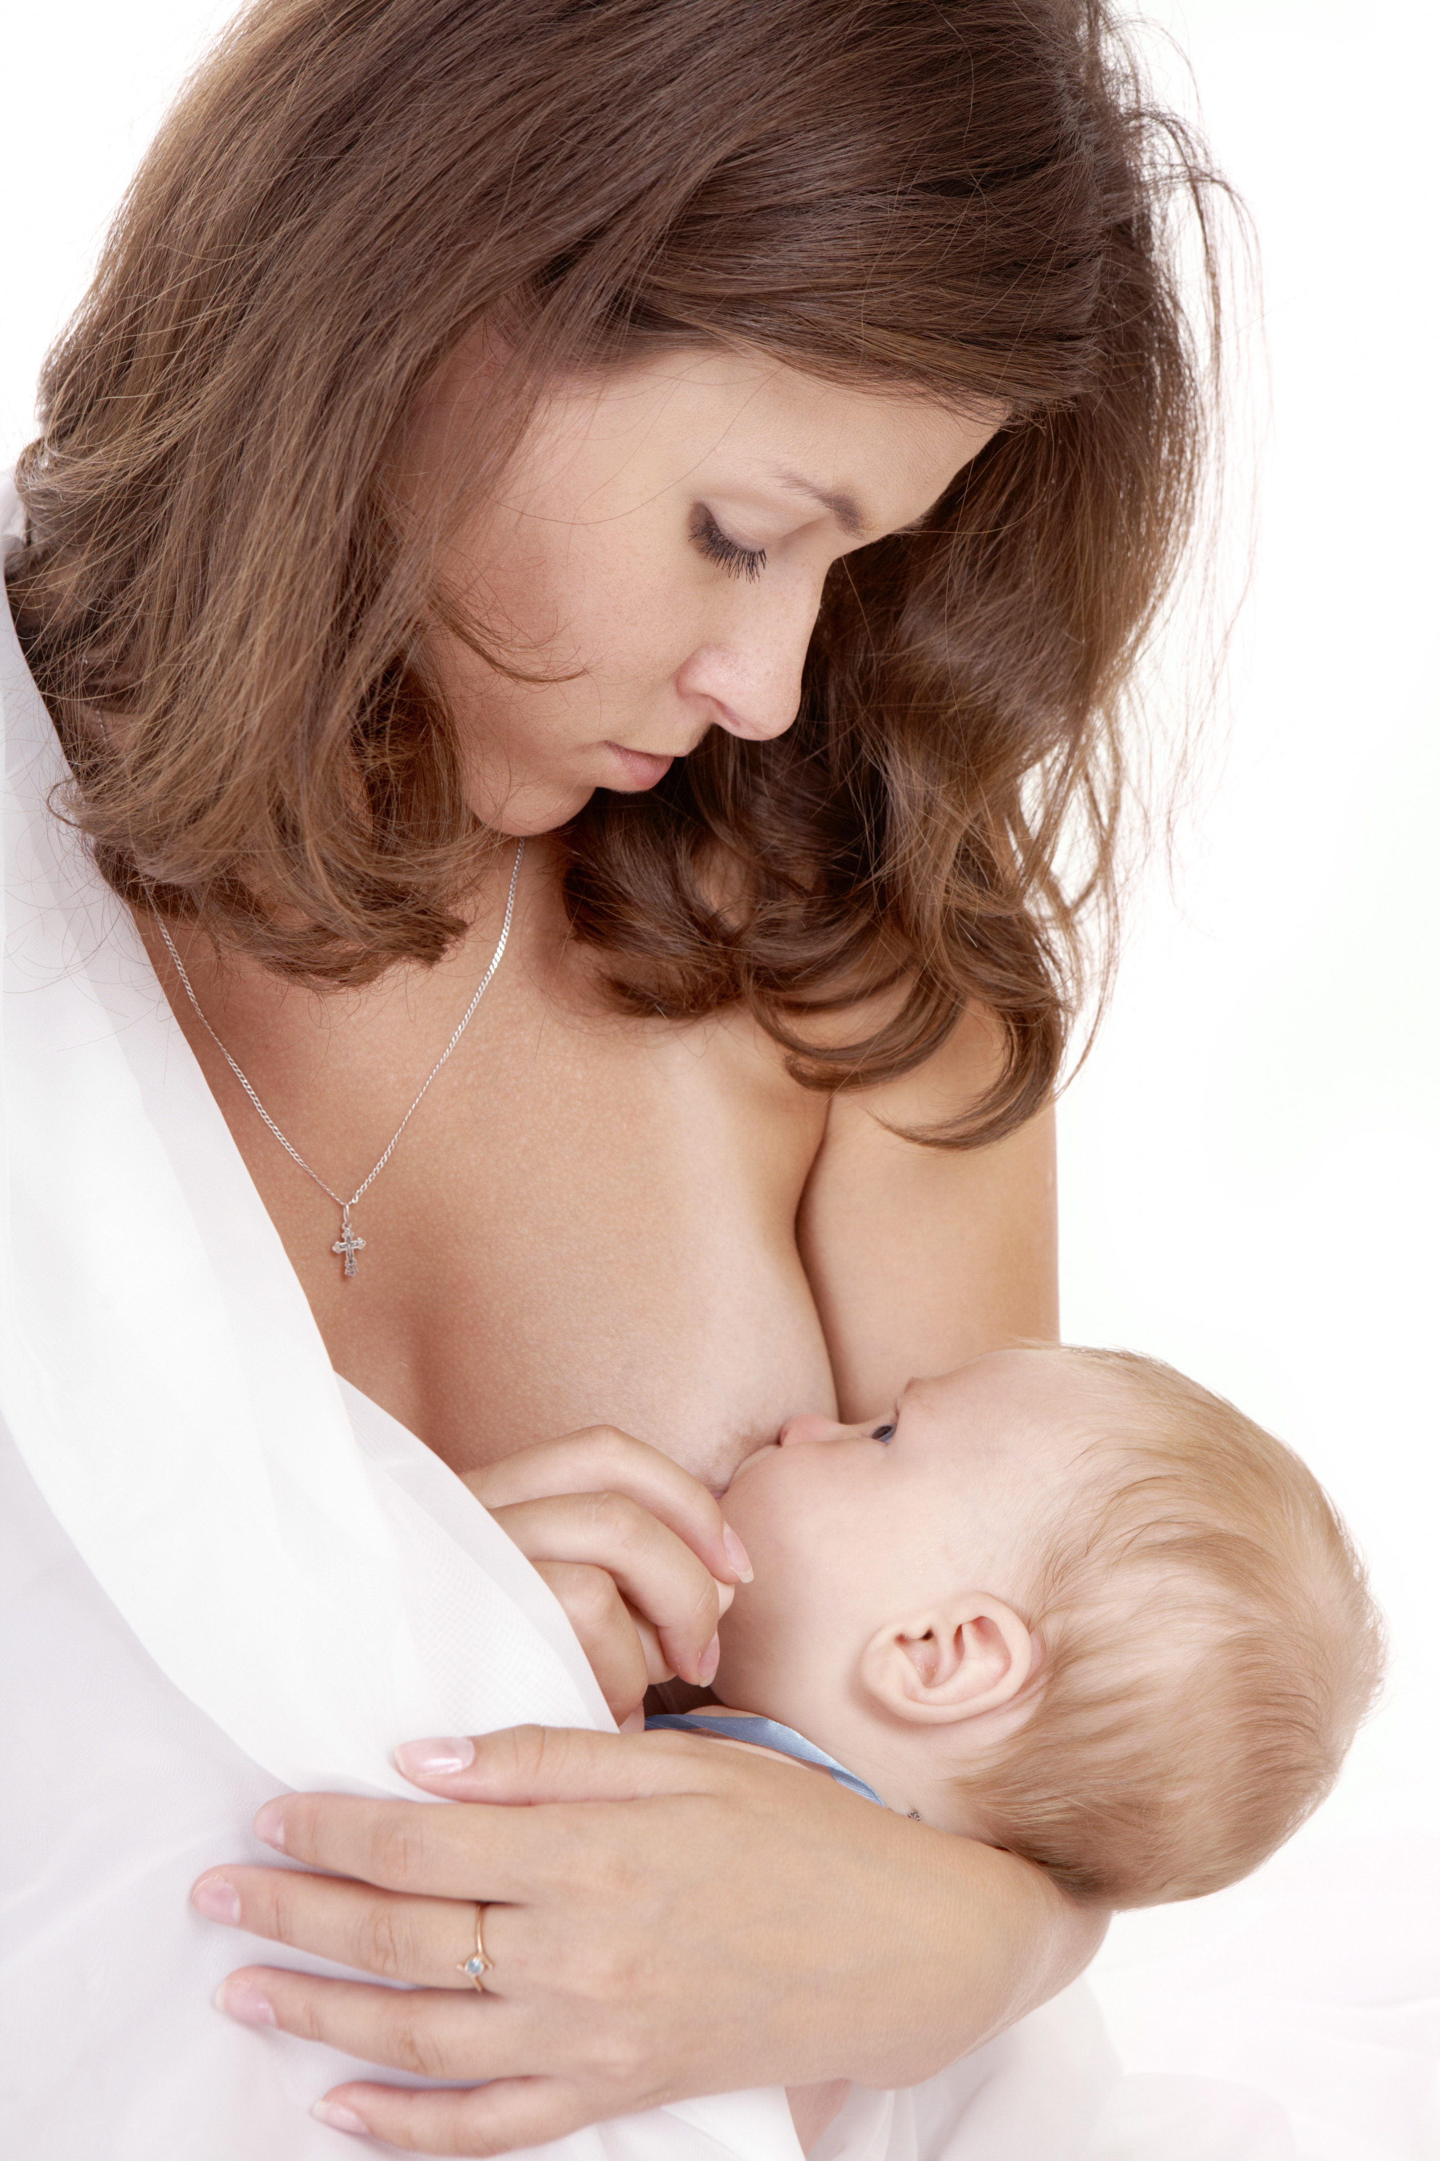
In one experiment, Harlow (1958) investigated the role played by breastfeeding in human infant–mother attachment.
Notes:
Insert image

Slide 4
Harlow, H.F. (1958). The nature of love.
American Psychologist, 13, 673–685.

Slide 5
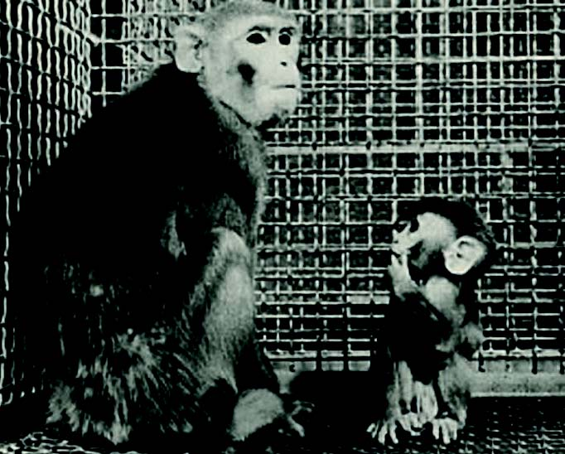
Participants
8 infant rhesus monkeys were separated from their mothers at birth.

Slide 6
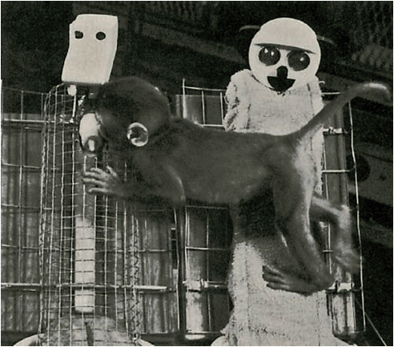
Procedure
Each monkey was then individually reared in a cage.
Each cage contained two surrogate mothers.
One surrogate was made entirely of wire mesh
One surrogate was wire mesh, but with a soft, cloth covering

Slide 7
Procedure
Group 1: 4 monkeys are each placed in a separate cage in which the cloth surrogate provides food and the wire surrogate does not
Group 2: 4 monkeys are each placed in a separate cage in which the wire surrogate provides food and cloth surrogate does not

Slide 8
Procedure
Observe each monkey’s preference for feeding from either the cloth or wire surrogate mother
Record the time spent each mother type

Slide 9
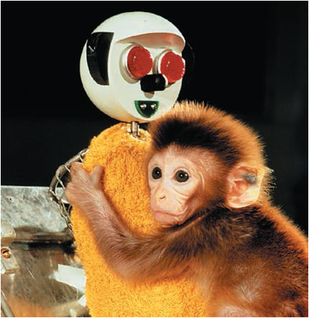
Results
Infants spent more time with the cloth mother, regardless of which surrogate provided the nourishment

Slide 10
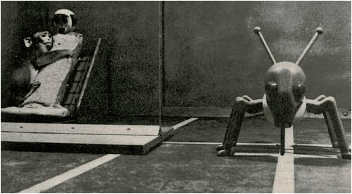
This preference is stronger when distressed eg. frightened by a mechanical object (toy spider)

Slide 11
Conclusion
Contact comfort’ (provided by the softness of the cloth covering) is more important than feeding in the formation of an infant rhesus monkey’s attachment to its mother.

Slide 12
Generalisation
Contact comfort is likely to be a crucial factor in human infant–parent attachment.

Slide 13
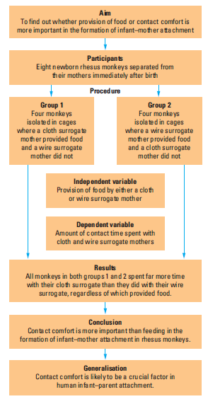
Aims and Participants

Slide 14
Procedure

Slide 15
Results, Conclusion & Generalisation

